Slide 1
Enhancing Functional Connectome Fingerprinting
with Deep Learning
Yashaswini
B.Tech (Electrical Engineering)
And
M.Tech (Signal Processing and Machine Learning)
20EE38020
Supervisor
Dr. Sanjay Ghosh
Assistant Professor,
Department of Electrical Engineering
30 April 2025
1

Slide 2
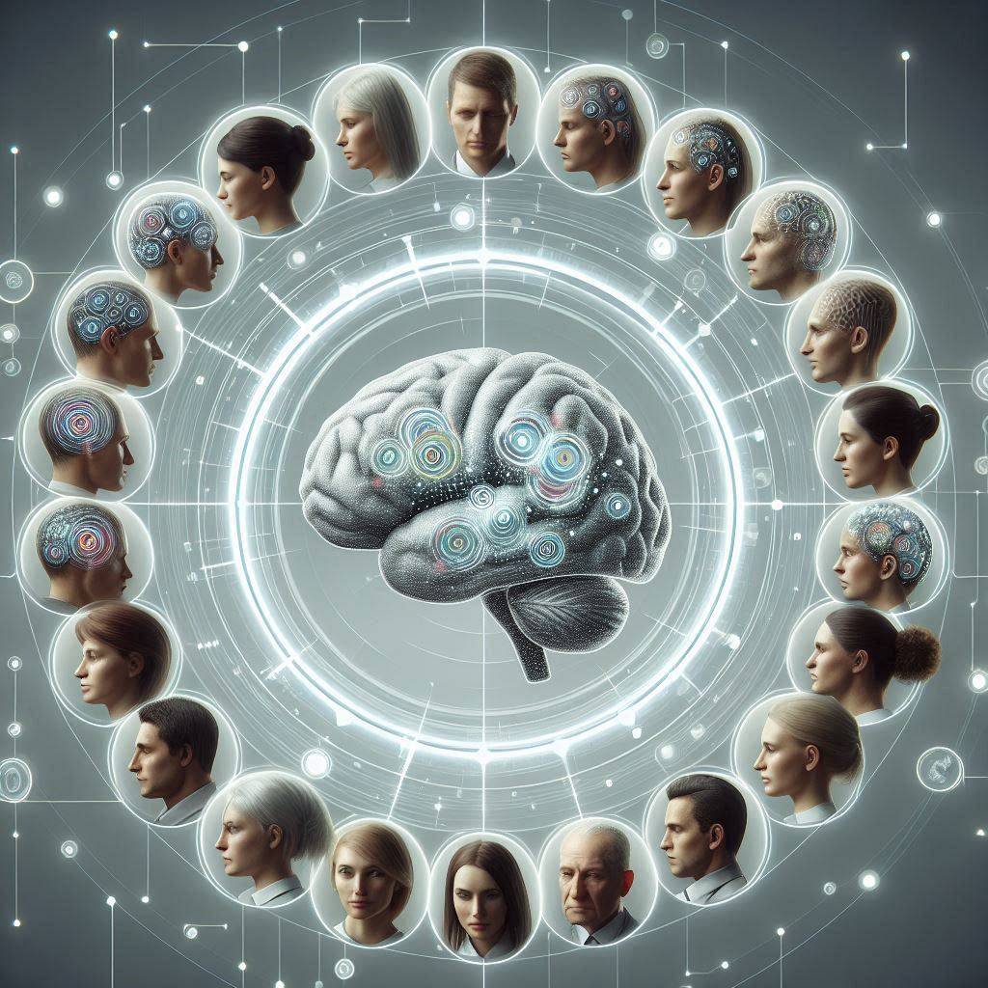
Brain Fingerprinting: Overview
We have unique brains with unique
Structural, functional and dynamical properties
Shaped by genetics, environment and experiences
Uniqueness is characterized by differences in
Learning
Memory
Cognitive processing
30/04/2025 Enhancing Functional Connectome Fingerprinting using Deep Learning 2

Slide 3
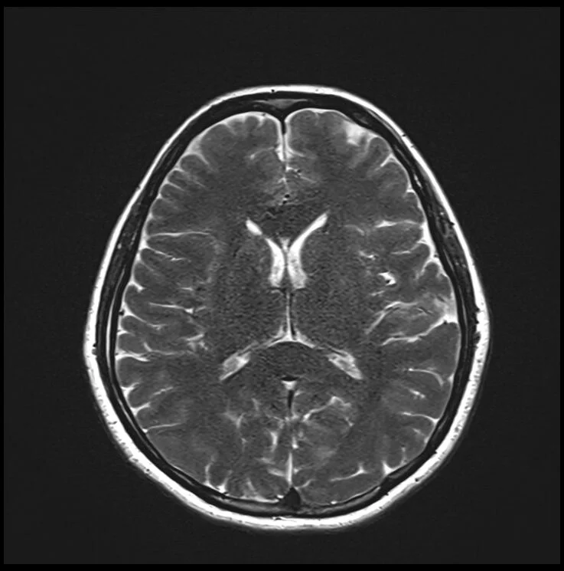
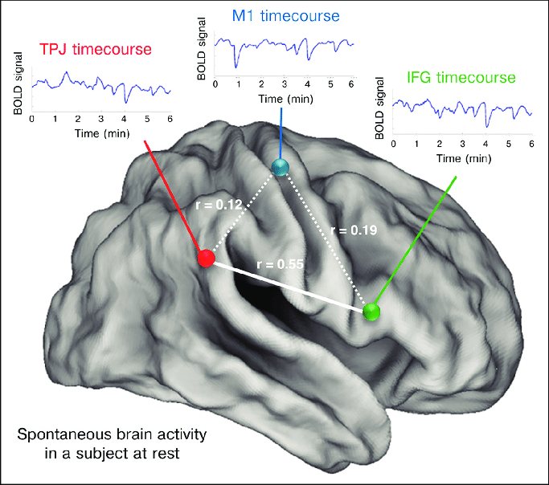
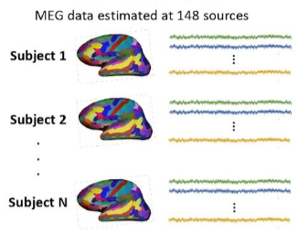
Brain Fingerprinting: Data Sources
Structural Connectivity (MRI) Functional Connectivity (fMRI) Electrophysiological (MEG/EEG)
fMRI: functional Magnetic Resonance Imaging; MEG/EEG: Magneto/ElectroEncephaloGram
30/04/2025 Enhancing Functional Connectome Fingerprinting using Deep Learning 3

Slide 4
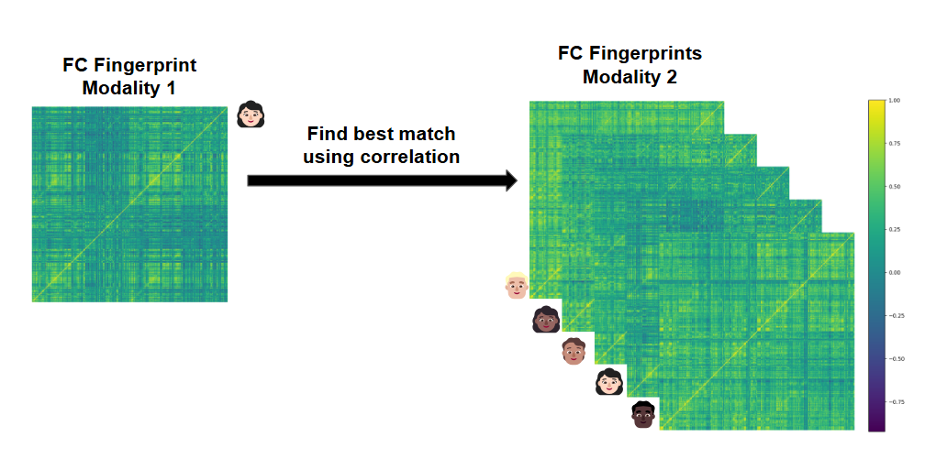
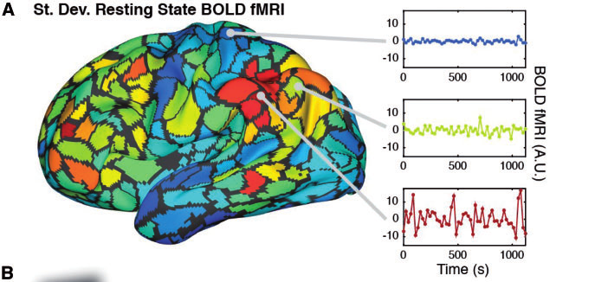
Problem Statement
Develop a robust brain fingerprinting framework to identify individuals
based on their functional connectomes (FC) (derived from fMRI data)
using signal processing and deep learning techniques
Pearson
Correlation
and
further processing
30/04/2025 Enhancing Functional Connectome Fingerprinting using Deep Learning 4

Slide 5
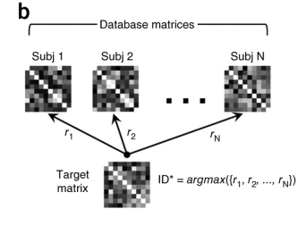
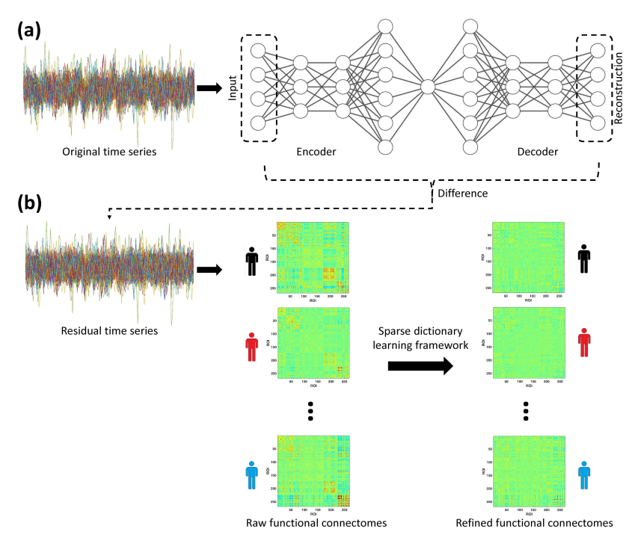
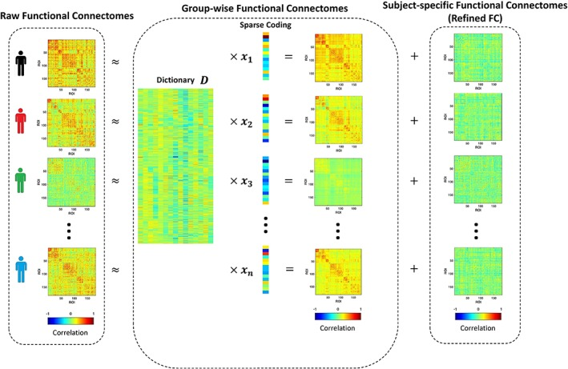
Literature Review: FC Fingerprint Extraction
Simple Correlation-Based Sparse Dictionary Learning Deep Learning
FC Fingerprint = FC FC Fingerprint = Residual FC FC Fingerprint = Refined FC
Reference: https://www.nature.com/articles/nn.4135 Reference:https://pmc.ncbi.nlm.nih.gov/articles/PMC6865523/ Reference:https://arxiv.org/abs/2006.09928
30/04/2025 Enhancing Functional Connectome Fingerprinting using Deep Learning 5

Slide 6
Proposed Solution Approach
Limitations of previous deep learning solutions:
Applying autoencoder directly on fMRI time series is computationally inefficient (approx. 3.75 M parameters)
It is less interpretable
Idea: Instead of common neural activities, what if we separate out most common neural connections across subjects
Representing common neural connections
Baseline: Group-Average Functional Connectomes (no training), Finn (2015)
Convolutional Autoencoder (approx. 33 K parameters)
30/04/2025 Enhancing Functional Connectome Fingerprinting using Deep Learning 6

Slide 7
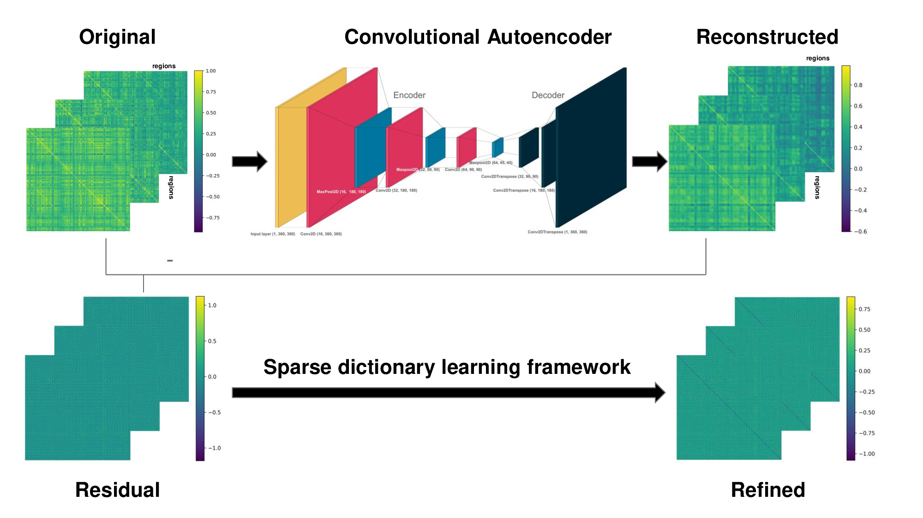
Proposed Solution Approach: Source data to Brain Fingerprint
fMRI Data Extraction and Preprocessing
30/04/2025 Enhancing Functional Connectome Fingerprinting using Deep Learning 7

Slide 8
Proposed Solution Approach: Source data to Brain Fingerprint
Functional Connectome Generation
30/04/2025 Enhancing Functional Connectome Fingerprinting using Deep Learning 8

Slide 9
Proposed Solution Approach: Source data to Brain Fingerprint
Training Convolutional Autoencoder to get Reconstructed FC
30/04/2025 Enhancing Functional Connectome Fingerprinting using Deep Learning 9

Slide 10
Proposed Solution Approach: Source data to Brain Fingerprint
“Group” FC
Subtract Reconstructed FC from Original FC to get Residual FC
“Individualistic” FC
30/04/2025 Enhancing Functional Connectome Fingerprinting using Deep Learning 10

Slide 11
Proposed Solution Approach: Source data to Brain Fingerprint
Sparse Dictionary Learning Framework to get Refined FC
30/04/2025 Enhancing Functional Connectome Fingerprinting using Deep Learning 11

Slide 12
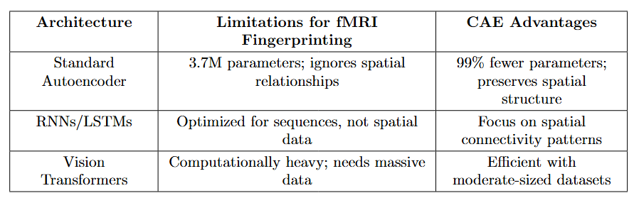
Proposed Solution Approach: Why Convolutional Autoencoder (CAE)
30/04/2025 Enhancing Functional Connectome Fingerprinting using Deep Learning 12

Slide 13
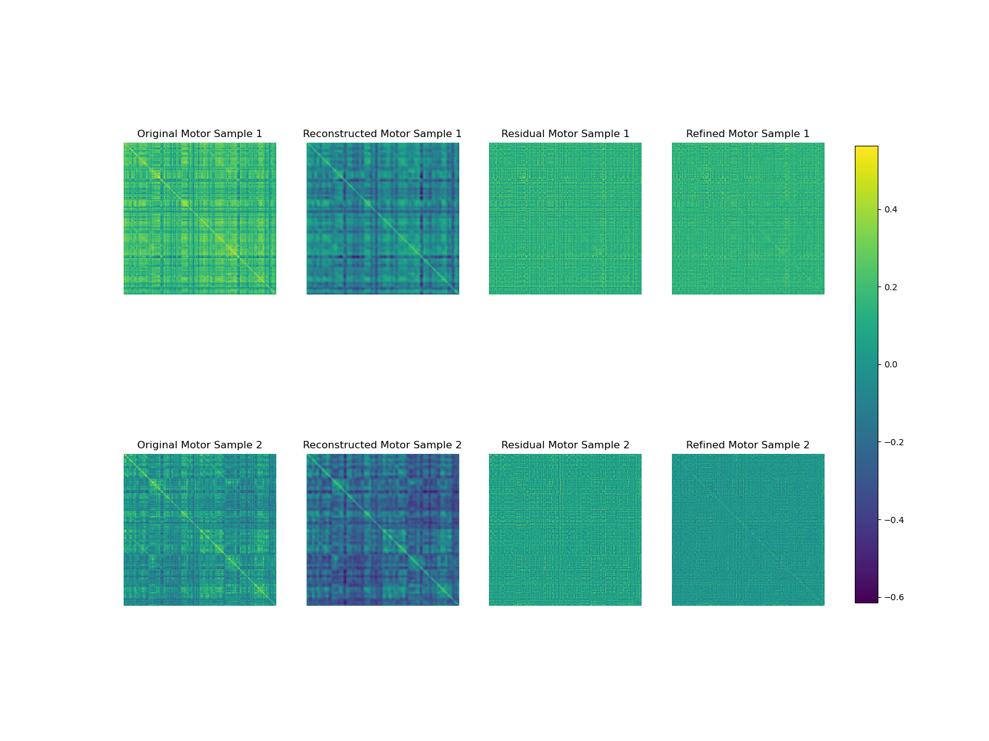
Proposed Solution Approach: Two sample example
ROI
ROI
ROI
ROI
ROI
Correlation →
ROI
ROI
ROI
ROI
ROI
30/04/2025 Enhancing Functional Connectome Fingerprinting using Deep Learning 13

Slide 14
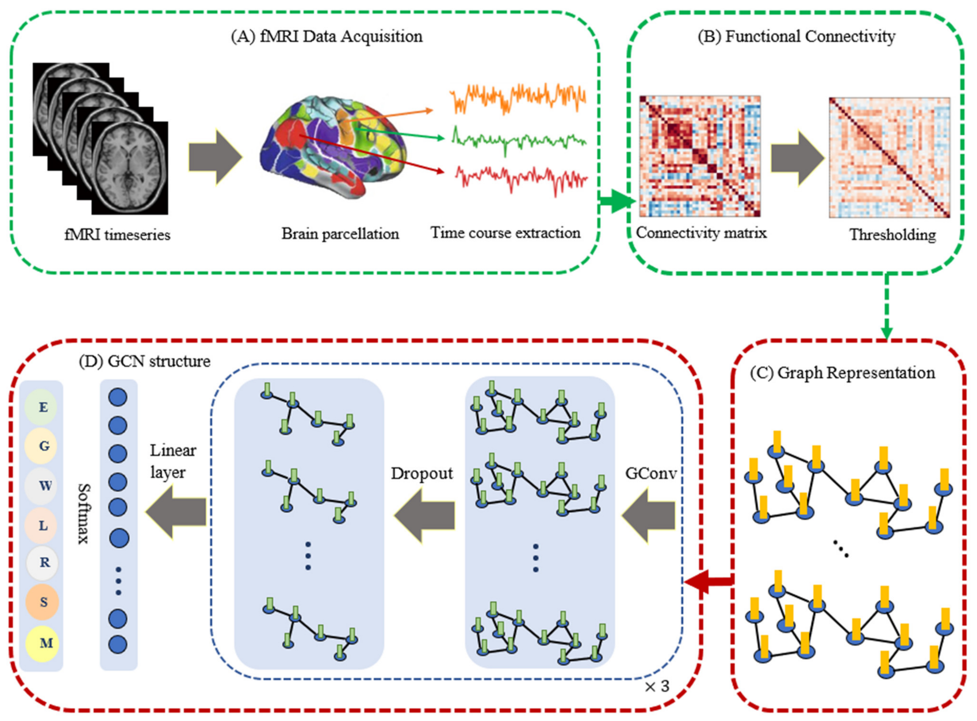
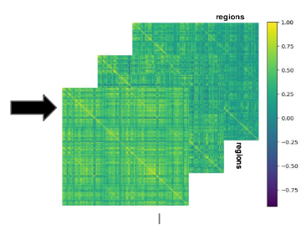
Proposed Solution Approach: Data Extraction and Preprocessing
fMRI data from subset of HCP (Human Connectome Project) dataset
4D (x, y, z, t) : (91 x 109 x 91, t)
for 339 subjects across resting state and tasks: motor, emotion, working memory, language etc.
Glasser Parcellation:
360 Regions of interest (ROI) over 12 functional networks
HCP Minimal Preprocessing Pipeline
Blood Oxygen Level Dependent (BOLD) time series signals for each ROI extracted
FC generated using Pearson Correlation between time series
30/04/2025 Enhancing Functional Connectome Fingerprinting using Deep Learning 14

Slide 15
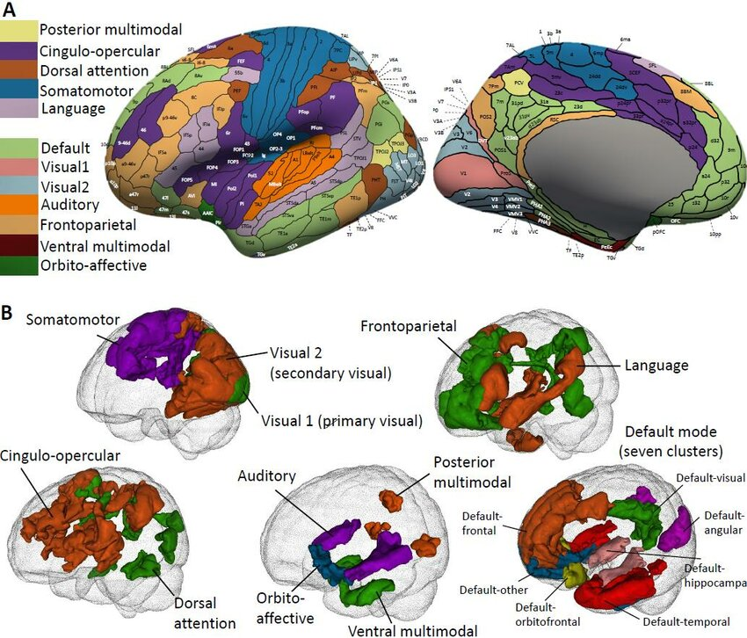
Glasser Parcellation
30/04/2025 Enhancing Functional Connectome Fingerprinting using Deep Learning 15

Slide 16
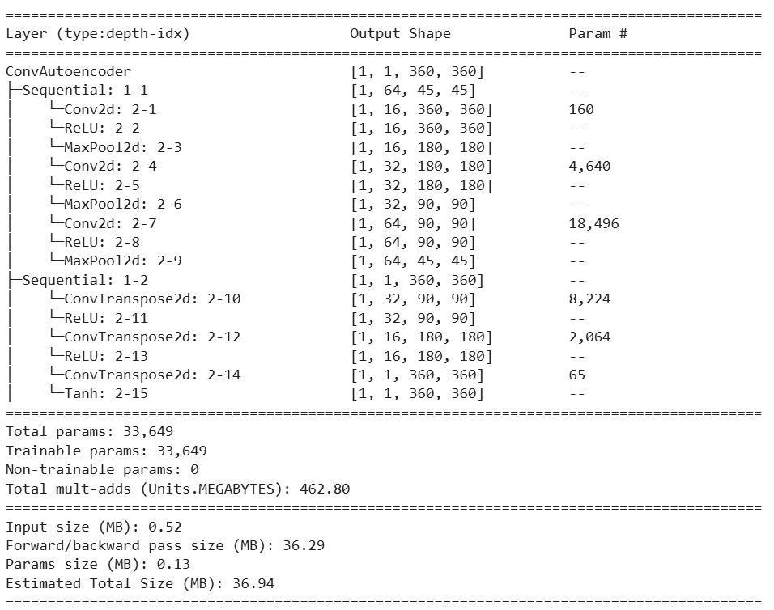
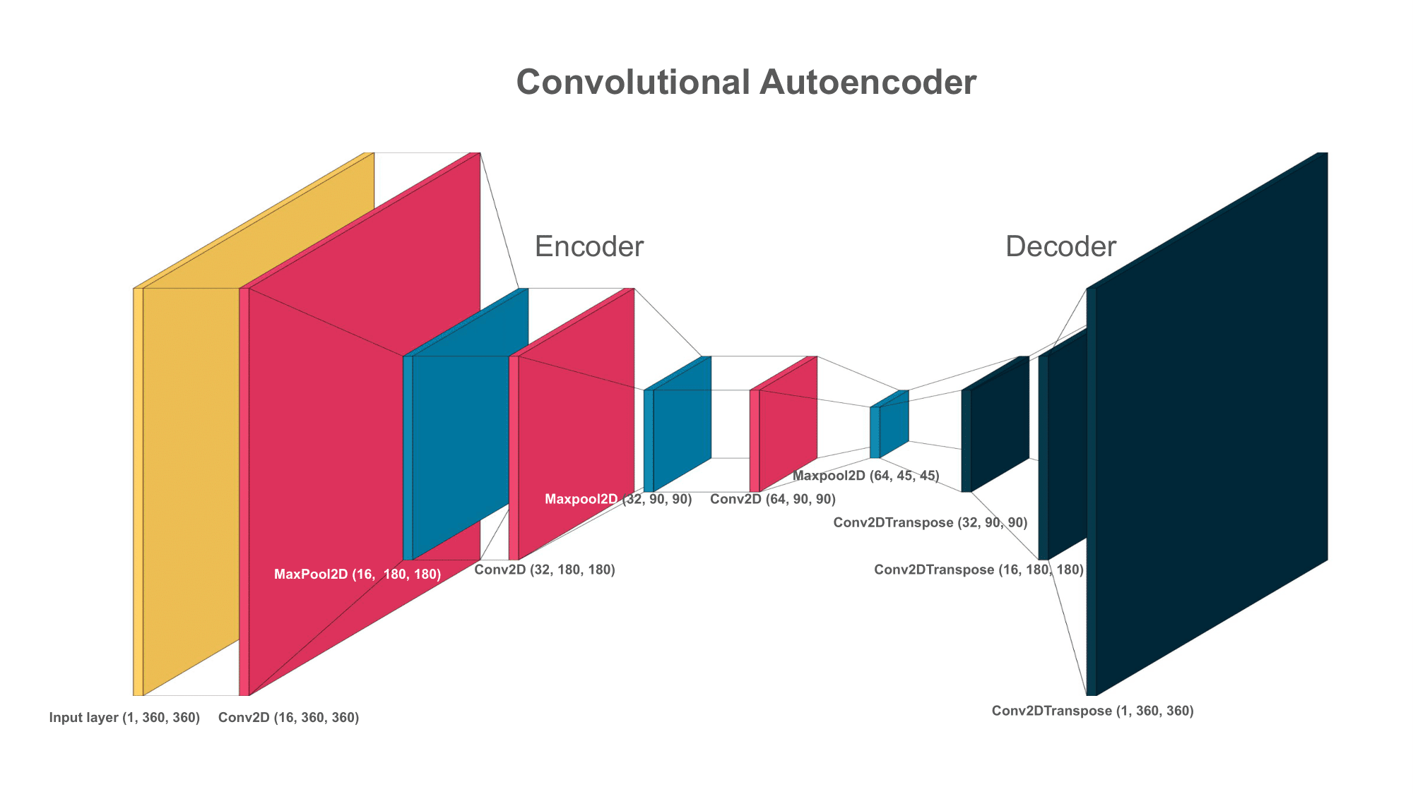
Proposed Solution Approach: CAE Construction
30/04/2025 Enhancing Functional Connectome Fingerprinting using Deep Learning 16

Slide 17
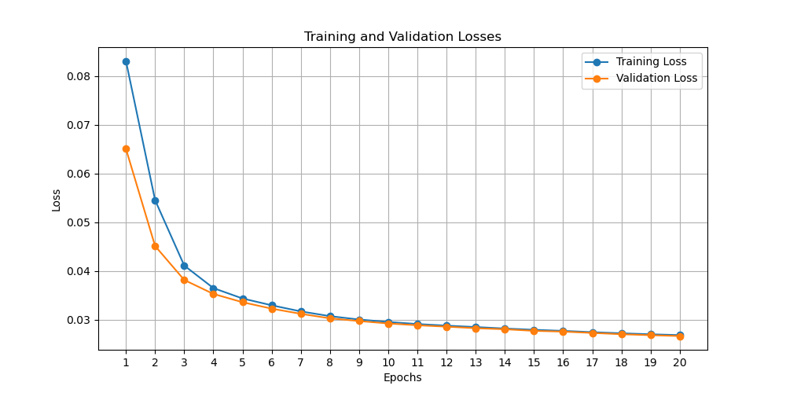
Proposed Solution Approach: Training CAE
Trained on Resting-state FC
Loss function = MSE Reconstruction error
Reconstructed output = group-wise FC
30/04/2025 Enhancing Functional Connectome Fingerprinting using Deep Learning 17

Slide 18
Proposed Solution Approach: SDL Theory (contd.)
Residual FC Group-wise FC using Sparse Coding Refined FC
30/04/2025 Enhancing Functional Connectome Fingerprinting using Deep Learning 18

Slide 19
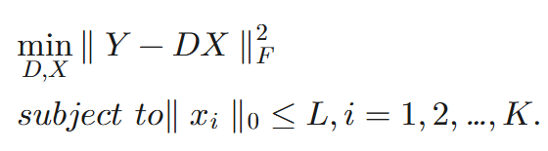
Proposed Solution Approach: SDL Theory (contd.)
Residual FC Group-wise FC using Sparse Coding Refined FC
L : model parameter to control the sparsity
level of dictionaries.
D ∈ ℝ^{m × K} : dictionaries
K : the size of dictionaries
X = [x₁, x₂, …, x_{K}] ∈ ℝ^{K × n} : representation matrix
∥ · ∥₀, ∥ · ∥_{F} : 0 and Frobenius norm
30/04/2025 Enhancing Functional Connectome Fingerprinting using Deep Learning 19

Slide 20
Proposed Solution Approach: SDL Implementation
k-SVD algorithm used for implementing Sparse Dictionary Learning
Initialize Dictionary
Sparse Coding using OMP Algorithm
Solve for X while keeping D fixed such that X is L-sparse
Dictionary update using SVD
D is refined to represent residuals keeping the sparsity of X fixed
Repeat until convergence
30/04/2025 Enhancing Functional Connectome Fingerprinting using Deep Learning 20

Slide 21
Baseline Solution Approach 1: Finn et. al. (2015)
Used for fingerprinting
30/04/2025 Enhancing Functional Connectome Fingerprinting using Deep Learning 21

Slide 22
Baseline Solution Approach 2: Group Average Functional Connectomes
Group Average
Averaged across all
subjects in dataset
30/04/2025 Enhancing Functional Connectome Fingerprinting using Deep Learning 21

Slide 23
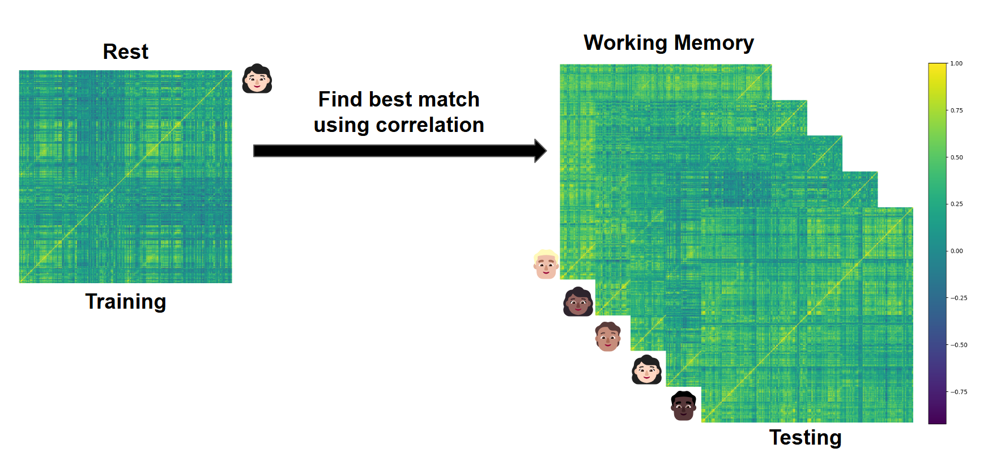
Individual Identification Accuracy
Goal: Given a target session (i.e., resting-state), identify the participant from a task session(i.e, Motor, Working Memory, Emotion) based on their refined FC.
Accuracy Evaluation: If the matched FCs belong to the same participant, accuracy = 100% else 0%
30/04/2025 Enhancing Functional Connectome Fingerprinting using Deep Learning 23

Slide 24
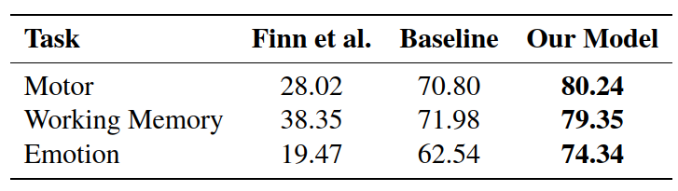
Results: Final Accuracy of Proposed Method
30/04/2025 Enhancing Functional Connectome Fingerprinting using Deep Learning 24

Slide 25
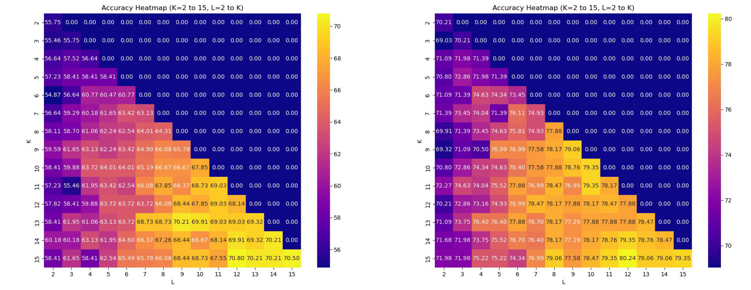
Results: Accuracy with respect to parameters (K and L)
Accuracies for different K and L values: On an average 10% higher on Motor Task
Accuracy →
Accuracy →
30/04/2025 Enhancing Functional Connectome Fingerprinting using Deep Learning 25

Slide 26
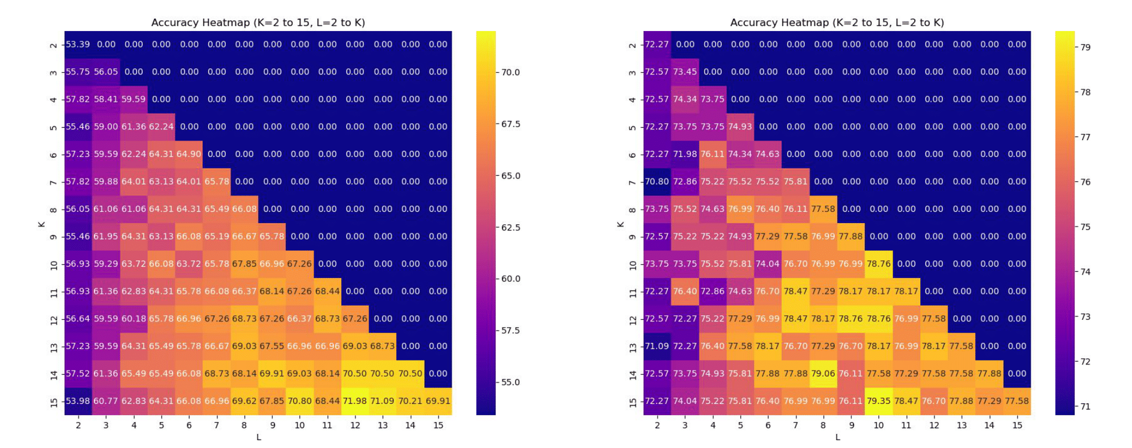
Results: Accuracy with respect to parameters (K and L)
Accuracies for different K and L values: On an average 10% higher on Working Memory Task
Accuracy →
Accuracy →
30/04/2025 Enhancing Functional Connectome Fingerprinting using Deep Learning 26

Slide 27
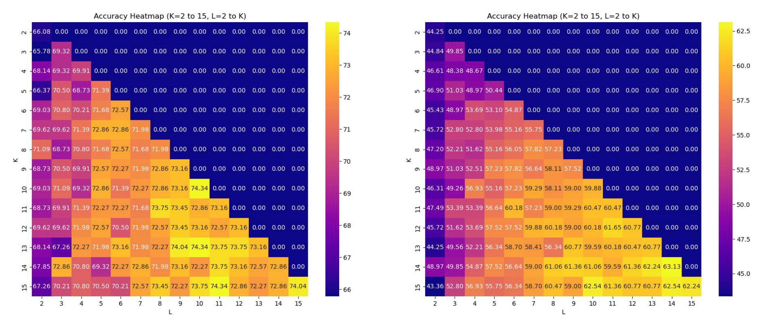
Results: Accuracy with respect to parameters (K and L)
Accuracies for different K and L values: On an average 10% higher on Emotion Task
Accuracy →
Accuracy →
30/04/2025 Enhancing Functional Connectome Fingerprinting using Deep Learning 27

Slide 28
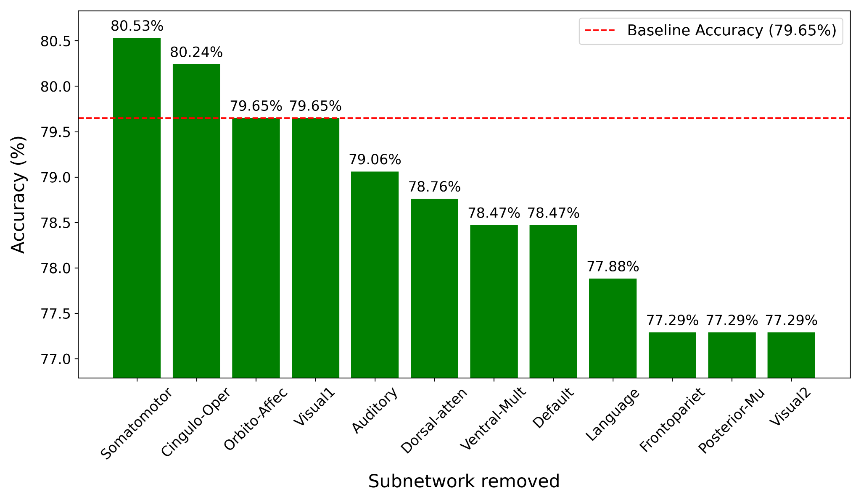
Results: Ablation Analysis - Motor Task
Largest Accuracy Decrease:
Frontoparietal network contribute to motor planning and control
Posterior-Mu likely reflects sensorimotor integration
Visual2 may support visuomotor coordination.
Accuracy increase: Excluding Cingulo-Oper and Somatomotor
These subnetworks may introduce redundancy or noise for this task or are not important for individual characterization
30/04/2025 Enhancing Functional Connectome Fingerprinting using Deep Learning 28
Notes:
Motor Task: Participants are presented with visual cues that ask them to either tap their left or right fingers, or squeeze their left or right toes, or move their tongue to map motor areas

Slide 29
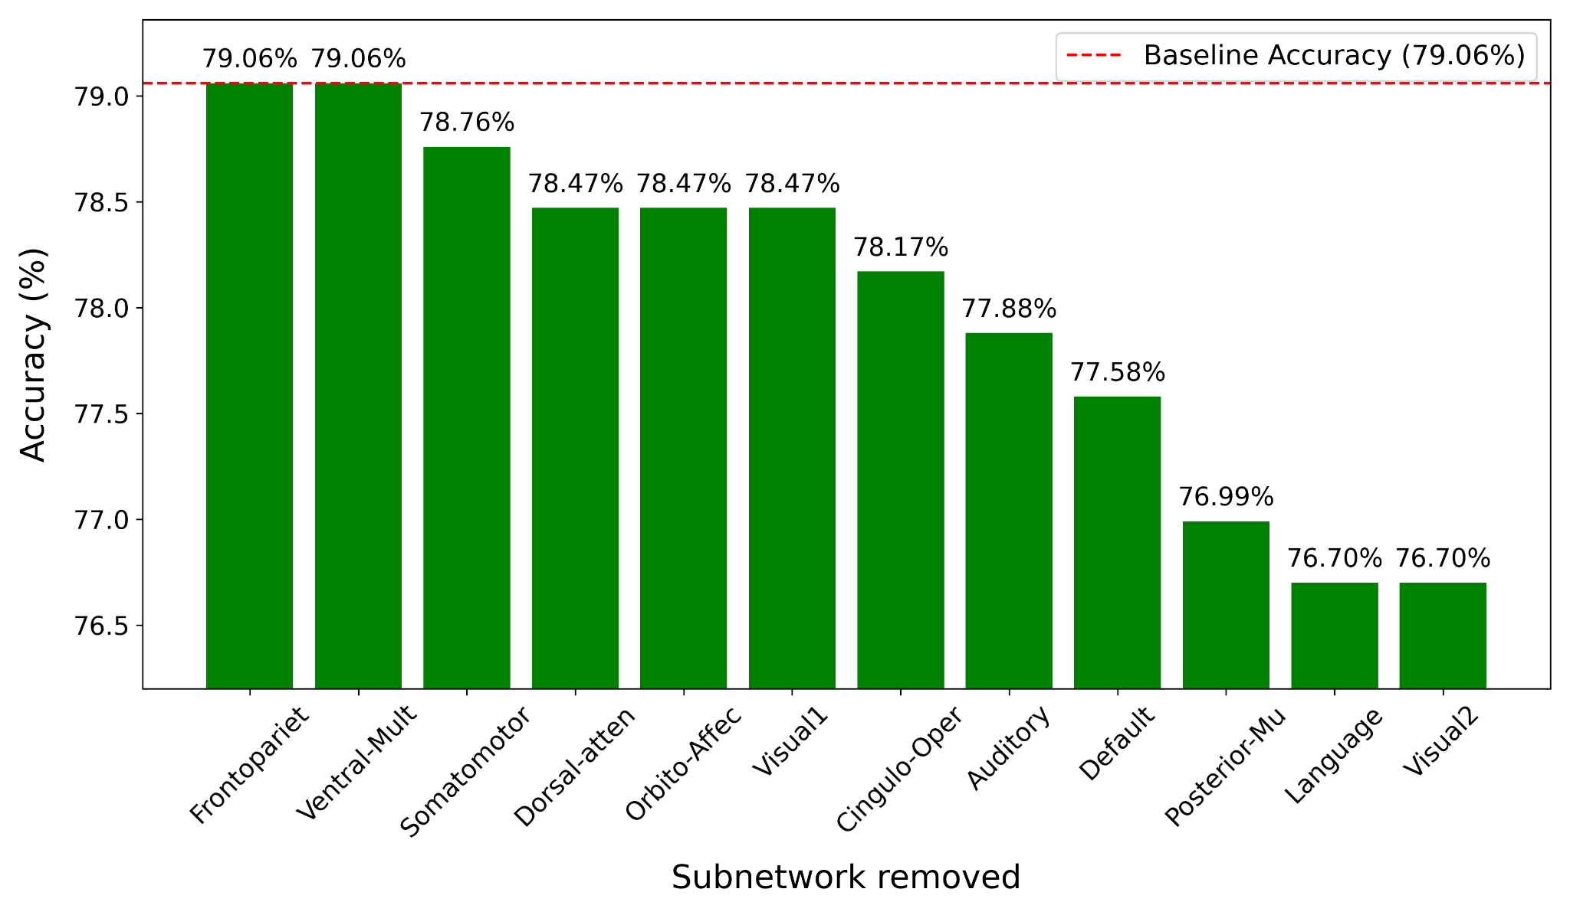
Results: Ablation Analysis - Working Memory Task
Largest Accuracy Decrease:
Language critical for working memory, especially for tasks requiring symbolic reasoning
Visual2 important for maintaining spatial or visual details in working memory
Minimal Impact on Accuracy:
Excluding Auditory, Cingulo-Oper, Frontopariet, or Ventral-Mult
30/04/2025 Enhancing Functional Connectome Fingerprinting using Deep Learning 29
Notes:
Working Memory Task: Participants were presented with blocks of trials that consisted of pictures of places, tools, faces and body parts (non-mutilated parts of bodies with no “nudity”). Within each run, the 4 different stimulus types were presented in separate blocks. Also, within each run, ½ of the blocks use a 2-back working memory task and ½ use a 0-back working memory task (as a working memory comparison). A 2.5 second cue indicates the task type (and target for 0-back) at the start of the block. Each of the two runs contains 8 task blocks (10 trials of 2.5 seconds each, for 25 seconds) and 4 fixation blocks (15 seconds). On each trial, the stimulus is presented for 2 seconds, followed by a 500 ms inter-task interval (ITI).

Slide 30
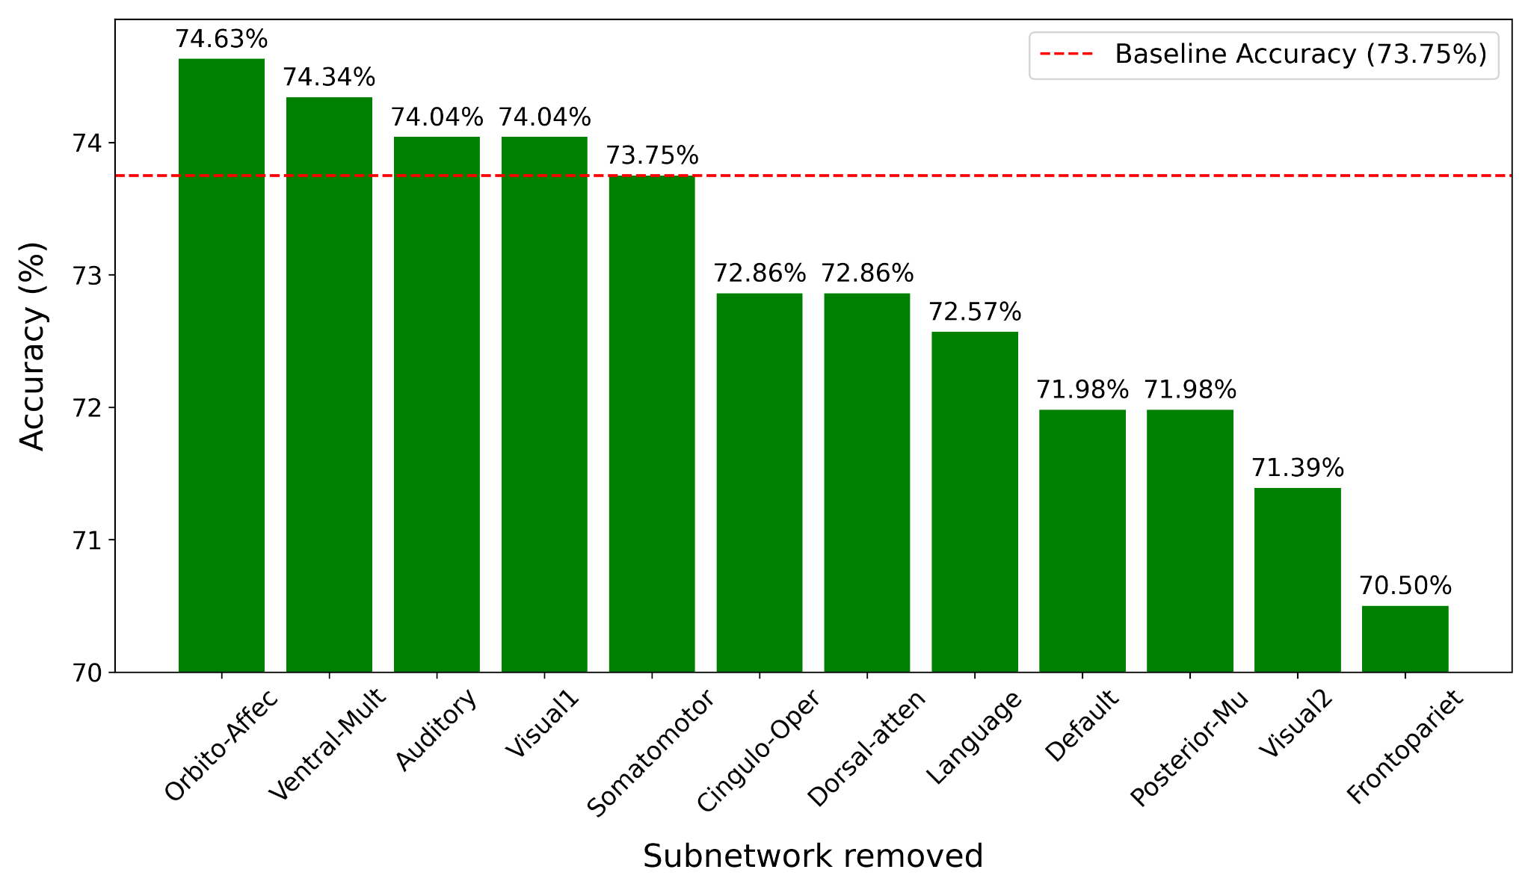
Results: Ablation Analysis - Emotion Task
Largest Accuracy Decrease:
Frontoparietal essential role in emotional regulation and integration
Visual2 Involved in visuospatial processing of emotional stimuli, particularly facial expressions.
Accuracy Increase:
Orbito-Affective, Ventral-Mult, Auditory, Visual1, results in slight accuracy increases or negligible.
These networks dont play a central role in individual fingerprinting for the emotion task
30/04/2025 Enhancing Functional Connectome Fingerprinting using Deep Learning 30
Notes:
Working Memory Task: Participants were presented with blocks of trials that consisted of pictures of places, tools, faces and body parts (non-mutilated parts of bodies with no “nudity”). Within each run, the 4 different stimulus types were presented in separate blocks. Also, within each run, ½ of the blocks use a 2-back working memory task and ½ use a 0-back working memory task (as a working memory comparison). A 2.5 second cue indicates the task type (and target for 0-back) at the start of the block. Each of the two runs contains 8 task blocks (10 trials of 2.5 seconds each, for 25 seconds) and 4 fixation blocks (15 seconds). On each trial, the stimulus is presented for 2 seconds, followed by a 500 ms inter-task interval (ITI).

Slide 31
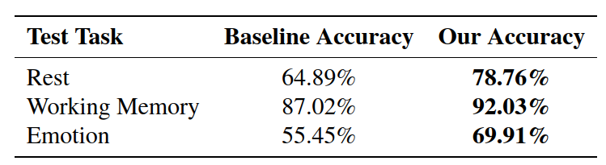
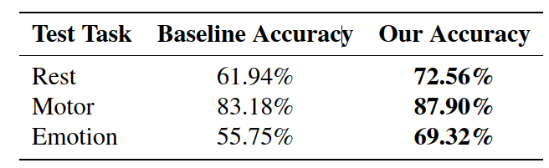
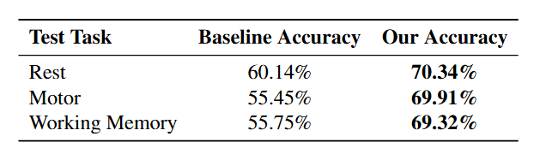
Results: Training on other tasks
Rest b) Motor
c) Working Memory d) Emotion
30/04/2025 Enhancing Functional Connectome Fingerprinting using Deep Learning 31
Notes:
Working Memory Task: Participants were presented with blocks of trials that consisted of pictures of places, tools, faces and body parts (non-mutilated parts of bodies with no “nudity”). Within each run, the 4 different stimulus types were presented in separate blocks. Also, within each run, ½ of the blocks use a 2-back working memory task and ½ use a 0-back working memory task (as a working memory comparison). A 2.5 second cue indicates the task type (and target for 0-back) at the start of the block. Each of the two runs contains 8 task blocks (10 trials of 2.5 seconds each, for 25 seconds) and 4 fixation blocks (15 seconds). On each trial, the stimulus is presented for 2 seconds, followed by a 500 ms inter-task interval (ITI).

Slide 32
Future Work
Other measures of functional connectivity - mutual information, various distance measures like Euclidean distance
Integrate Convolutional Autoencoder and Sparse Dictionary Learning into a single framework
k-Sparse Autoencoder
Deep Dictionary Learning
Using the FC Fingerprints obtained for downstream tasks
Predictive cognitive functions (Ex: fluid intelligence, problem solving skills)
Individualized diagnosis of neurological disorders
30/04/2025 Enhancing Functional Connectome Fingerprinting using Deep Learning 32

Slide 33
Conclusion
Functional Connectivity is a good measure for individualized brain connectivity analysis
Functional Connectome Fingerprinting has applications in personalized treatment of neurological disorders and also in cognitive state decoding
As the number of fMRI datasets increase, there are chances of missing labels. Functional Connectome Fingerprinting can be a good way to tackle this issue
30/04/2025 Enhancing Functional Connectome Fingerprinting using Deep Learning 33

Slide 34
References
[1] Finn ES, Shen X, Scheinost D, Rosenberg MD, Huang J, Chun MM, Papademetris X, Constable RT. Functional connectome fingerprinting: identifying individuals using patterns of brain connectivity. Nat Neurosci. 2015 Nov;18(11)
[2] Cai B, Zhang G, Hu W, Zhang A, Zille P, Zhang Y, Stephen JM, Wilson TW, Calhoun VD, Wang YP. Refined measure of functional connectomes for improved identifiability and prediction. Hum Brain Mapp. 2019 Nov
[3] Cai, Biao, et al. "Functional connectome fingerprinting: identifying individuals and predicting cognitive functions via autoencoder." Human Brain Mapping 42.9 (2021): 2691-2705.
Publication
Yashaswini and S. Ghosh, "Enhancing Functional Connectome Fingerprinting using Deep Learning," IEEE Transactions on Medical Imaging. (in-preparation)
30/04/2025 Enhancing Functional Connectome Fingerprinting using Deep Learning 34

Slide 35
Thank you!

Slide 36
Appendix

Slide 37
HCP minimal preprocessing pipeline
Gradient Distortion Correction: Compensates for MRI gradient coil-induced distortions.
Head Motion Correction: Realigns volumes to correct for subject movement (FIX-based ICA denoising).
Image Distortion Correction: Addresses echo-planar imaging (EPI) distortions.
Spatial Normalization: Aligns images to MNI standard space for cross-subject consistency.
Intensity Normalization: Standardizes signal intensity across scans.
Temporal Filtering:
Detrending: Removes linear trends in BOLD signals.
Band-pass filter (0.01–0.25 Hz): Reduces low-frequency drift and high-frequency noise.
Spatial Smoothing: Omitted per Finn et al. (2015) findings on minimal impact on fingerprinting accuracy.

Slide 38
AE vs Conv-AE Network Parameter Calculations
AE (architectured as mentioned in the reference paper):
d-500-500-2000-10-2000-500- 500-d where d = number of time points
For resting state fMRI, d = 1200
Number of params = 1200×500+500 + 500×500+500 + 500×2000+2000 + 2000×10+10 + 10×2000+2000 + 2000×500+500 + 500×500+500 + 500×1200+1200 = 3,747,210
Conv AE (proposed architecture):
Number of params = 1×16×3×3 + 16 + 16×32×3×3 + 32 + 32×64×3×3 + 64 + 64×32×2×2 + 32 + 32×16×2×2 + 16 + 16×1×2×2 + 1 = 33,649

Slide 39
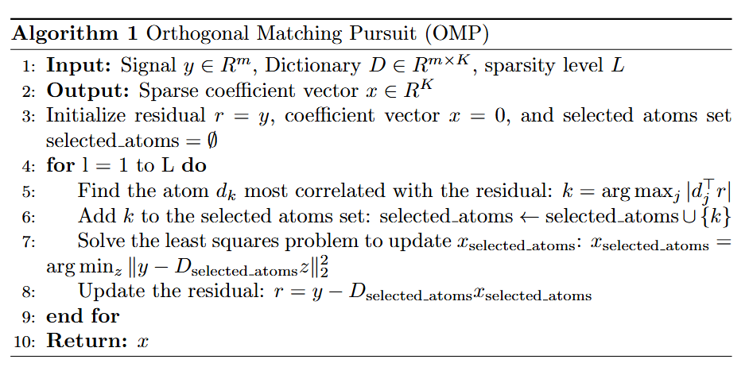
Orthogonal Matching Pursuit Algorithm

Slide 40
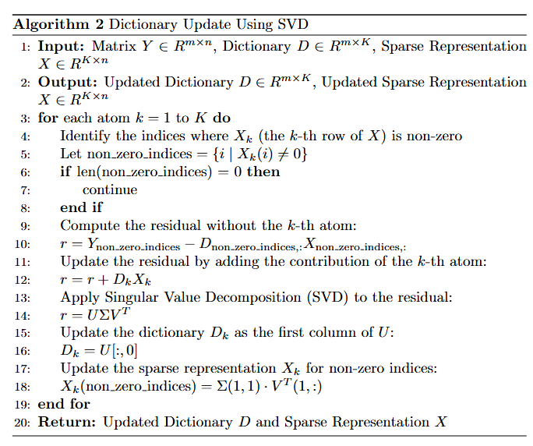
Dictionary update using SVD

Slide 41
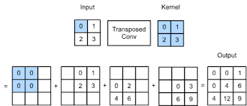
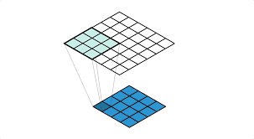
Transposed Convolution

Slide 42
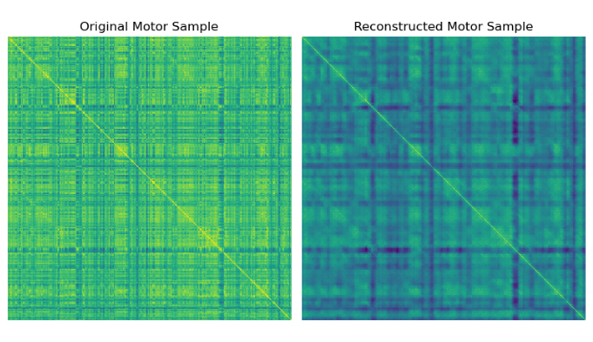
Why reconstructed FCs represent group-wise connections?
Trained across subjects - captures patterns common across the group
CAE compresses and reconstructs inputs - inherently identifies most salient connections
Trained using reconstruction loss - penalizes deviations from population-level patterns i.e, effectively computes a group-average like representation but with more sensitivity to non-linear representations

Slide 43
How SDL acts as a feature magnifier ?
The residual FC contain subject-specific connectivity features - but noisy since high dim
SDL acts a pattern compressor - learns a dictionary of “atoms” that frequently appear across subjects. Each residual FC sparse combination of these atoms
Enforcing sparsity => amplifies discriminative features, suppresses variations

Slide 44
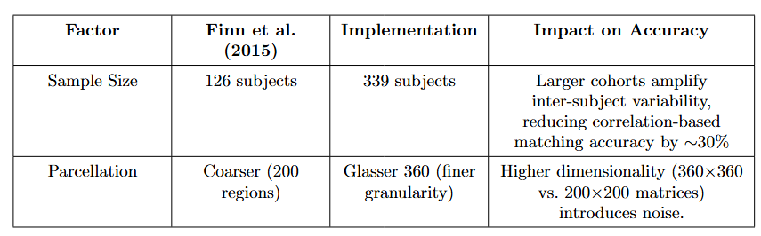
Low performance of Finn et. al. (2015)

